Slide 1


AMERICAN UNIVERSITY Online Marketing Strategy Analyses
ITEC – 660: BUSINESS INTELLIGENCE
COURSE PROJECT BY:
GROUP SEVEN [7]

Slide 2
Objectives
Evaluate Online Marketing Efficiency
Analyze Channels, Geographic and Demographics of Students
Showcase Dashboards for Leadership Insights

Slide 3

Has American University's Marketing Strategy Failed?

Slide 4
Findings/Insights
Large states with metropolitan centers had the biggest contribution to enrollment
02
Online marketing inadvertently increases in Bachelor enrollment
03
American University has spent about $2.3M to generate lead (2012 – 2017)
01
AU strategy has not failed! YAY
04

Slide 5
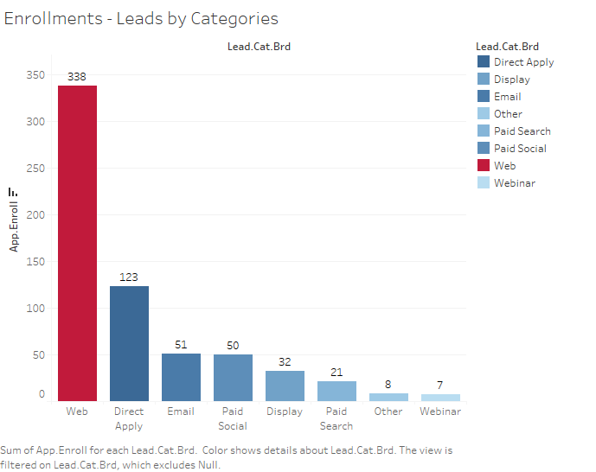
Medium Enrollment Outcome
Web generates 52% Enrollments
This strategy increased the Masters enrollments

Slide 6
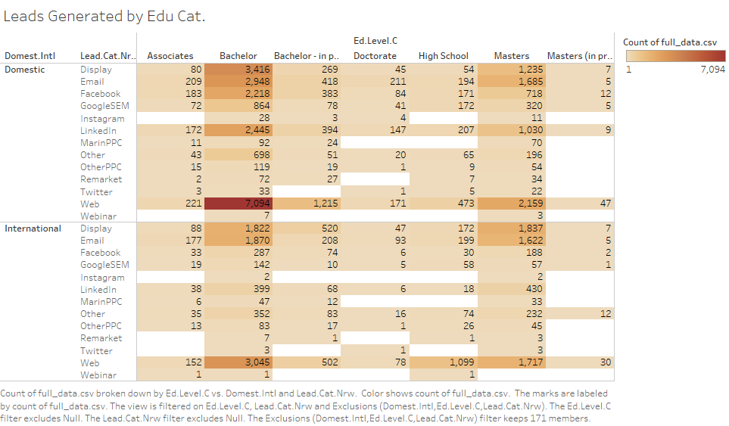
Leads Generated by Education Category
The web method is the most effective I generating leads from both domestic and international students
Social network methods generate fewer leads for international students than for domestic students
Twitter and Remarketing methods draw the least attention from students
The university can customize the investment of each website to place advertisements according to the different requirements of different students

Slide 7
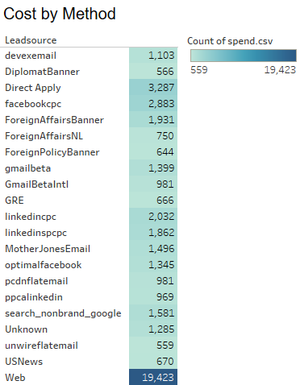
Lead Source Cost by Method
The lead source that generated the most advertising spend was "Website“, which suggests that it is an important driver of traffic and enrollment
The "Direct Mail" and "Email" sources had relatively low levels of advertising spend compared to the other sources indicating these channels are less effective
A significant drop-off in advertising spending between the two sources ("Website" and “Diplomat Banner"), suggests that the business may be focusing its advertising efforts on a relatively small number of channels and that there may be opportunities to diversify its advertising strategy to reach new prospects

Slide 8
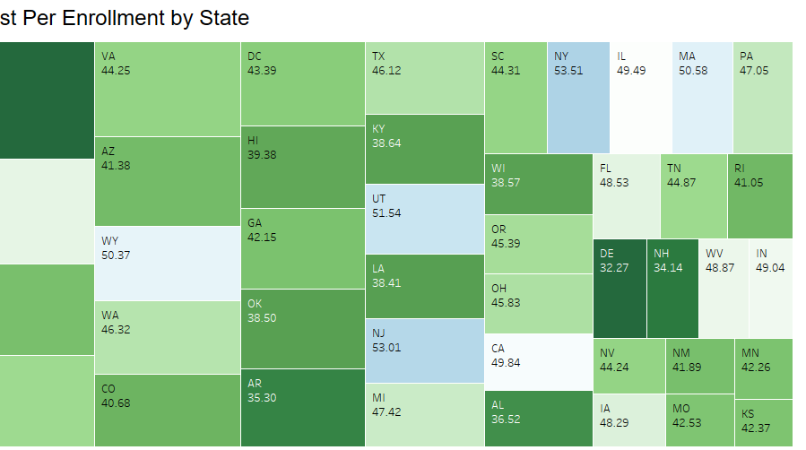
Average Lead Cost & Average Cost Per Enrollment by State
The upper chart is the average lead cost by state, and the lower chart is the average cost per enrollment by state
The states with the highest lead costs are New York(53.55), New Jersey(53.01) and South Dakota(53.57)
The states with the lowest lead cost are Montana(32.37), New Hampshire(34.40), and Delaware(32.27)
The cost appears to be higher in the East Coast and States with larger population

Slide 9
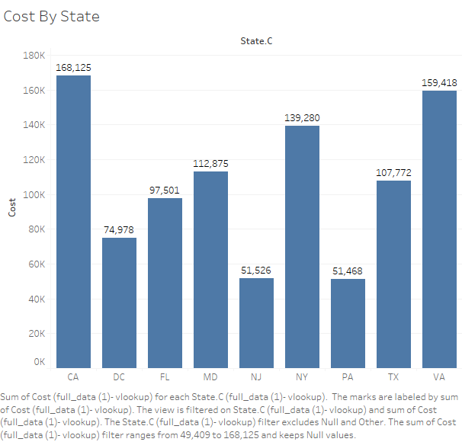
Cost by State Analysis
California (CA) has the highest marketing spend of 168,125.00, followed by VA and NY. It's important to evaluate the enrollment outcomes in these states to ensure that the marketing spend is justified and delivering desired results.
In contrast, New Jersey (NJ) and Pennsylvania (PA) have significantly lower marketing spends at 51,526.00 and 51,468.00, respectively. Investigate the enrollment rates in these states and assess whether there's potential for increasing marketing investments to boost enrollment numbers.
The marketing spend in Texas (TX) and Florida (FL) is moderate at 107,772.00 and 97,501.00, respectively. Review the performance of marketing campaigns in these states and identify opportunities to optimize the existing spend for better results.

Slide 10
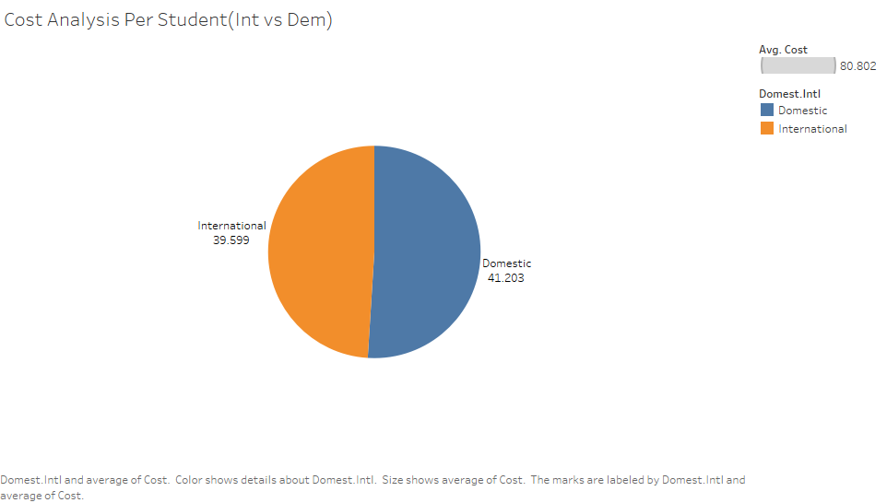
Cost Analysis Per Student: International vs. Domestic
The average cost for Domestic students is $41,203.00, slightly higher than Int. students at $39,599.00. This could be due to differences in local marketing efforts or enrollment-related expenses
The overall cost for both Domestic and International students combined is $80,802.00, indicating that the budget is almost equally allocated between the two groups. This may reflect a strategic focus on attracting and enrolling students from various backgrounds and regions

Slide 11
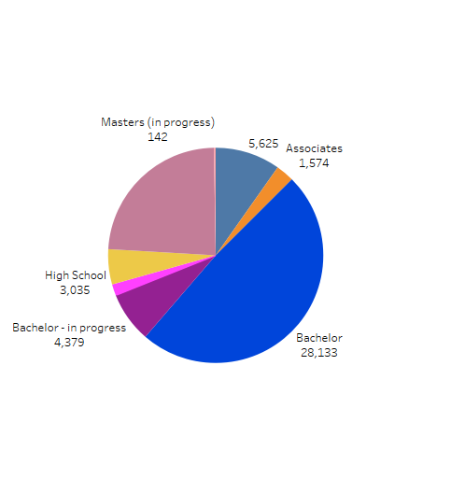
Previous Education of Enrolled Students
Over 50% of Enrolled Students have bachelor’s degree as their prior education
About 27% of Enrolled Student’s previous education has a master’s degree
University can conduct online recruiting to promote Master's program and Doctor program offerings
Through investigation, the university can invest more in advertising aimed at college students interested in course schedules, alums’ success stories, and how the university can be helpful to future work

Slide 12
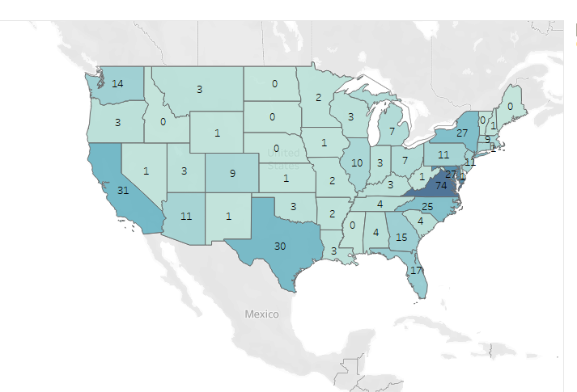
Number of Enrollment by State
Surprisingly, Montana has the highest Average enrollment rate with the lowest lead cost
South Dakota has the most expensive lead cost, but the enrollment rate is 0
Enrollments predominantly come from states with larger populations
Schools should conduct online recruiting in states with larger populations even the cost is higher

Slide 13
Recommendations
Enhance marking strategies by allocating increased budget to states with a proven track record of higher enrollment rates
Enhance the university's website to provide a seamless user experience, as it accounts for 52% of enrollments.
Focus on user satisfaction by implementing a responsive design, easy navigation, and relevant content
Strengthen the university's online presence across social media platforms, Wikipedia, and other relevant web channels to expand its reach and reputation
Maintain the focus on allocating marketing resources to states with high enrollment rates.
Explore opportunities for strategic partnerships in other states to increase enrollment from underrepresented regions
Increase bachelor retention post-graduation for Masters' programs.
The university should assess the cost-effectiveness of their marketing and enrollment strategies for both Domestic and International students. By evaluating key metrics such as conversion rates, retention rates, and the average cost per enrolled student, they can identify areas for improvement and optimize resource allocation

Slide 14
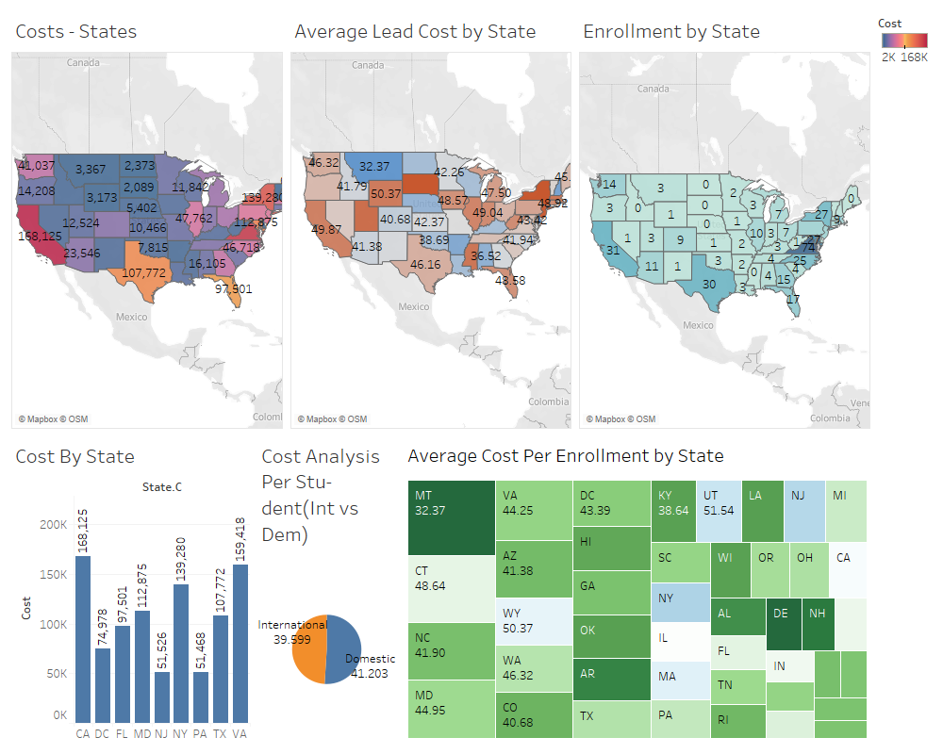
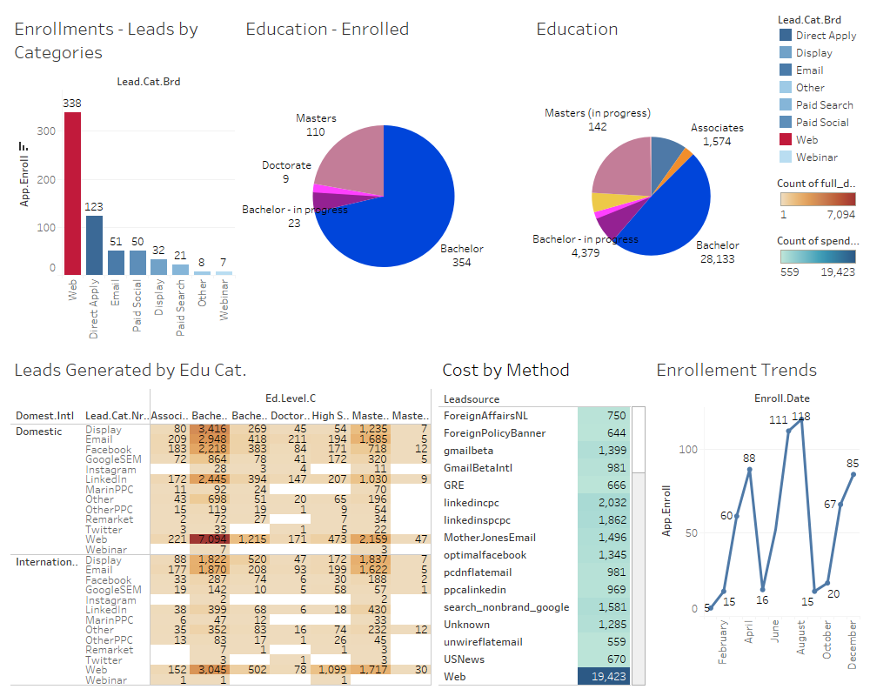

Slide 15

Thank You!
Q&A

Slide 16
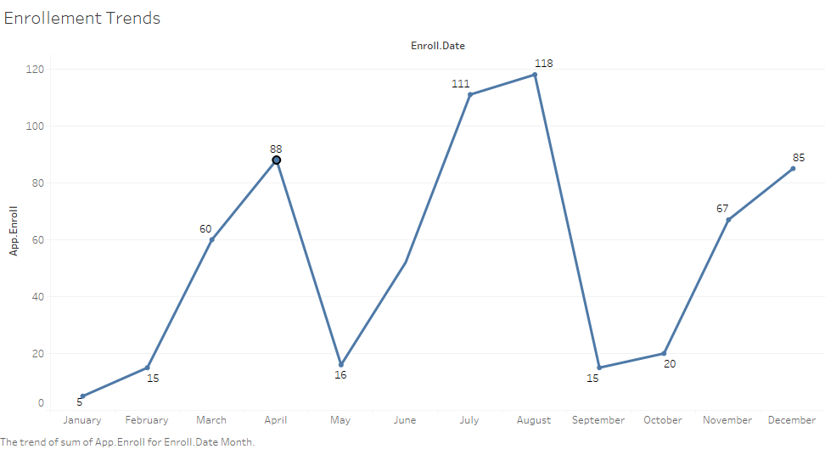
Enrollment Trends
May
Upward trend in enrollment numbers with a notable drop in May, implying consistent growth till April
July and August
The months of July and August registered the most significant number of enrollments
April
Indicates variations in enrollment numbers with April having the highest number of enrollments, followed by a drop in May and a steep increase in July
Sep.–Oct.
Enrollment numbers decreased from September to October, but picked up again from October to December

Slide 17
